Slide 1
Bonus: POCing Alpine Vulnerabilities

Slide 2
Session Outline
Brief introduction on how to reproduce a vulnerability within Alpine
When to PoC, What information is needed
How to build the package within Alpine to make PoCing easier
Follow Along! There will be homework after this session

Slide 3
Current Triage Process
Things to consider before adding an upstream vulnerability to the VMS
Upstream Maintainer Disputed
Disputed by the Debian Security team
Not enough information provided by the Source
If Debian Security team considers a vuln to an issue and are working on a fix, we should add it too
No need for a Proof of Concept for Linux Vulns in most cases

Slide 4
Scenarios when trying to PoC
Scenario 1: Published with Proof of Concept/Exploit
Scenario 2: Published with crash Information and information regarding vulnerable code
Scenario 3: Published with only vulnerable code
It might not be possible to provide full assurance that the vulnerability might exist within Alpine, However this is the case for many vulnerabilities within the Linux ecosystem.

Slide 5
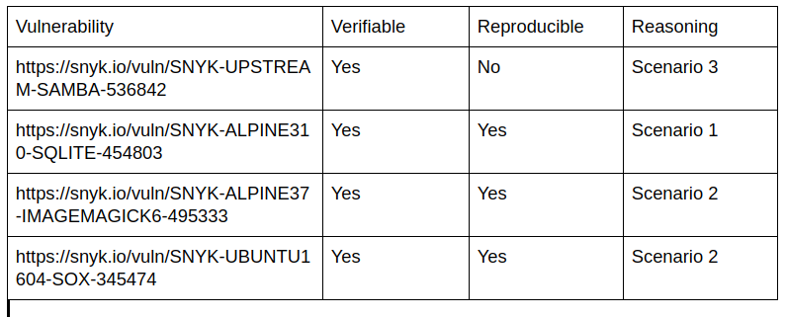

Slide 6
Scenario 2 - A Working Example
Vulnerability: https://snyk.io/vuln/SNYK-UBUNTU1604-SOX-345474
Package: SoX 14.4.2
Vulnerability: Integer Overflow
Reference: https://sourceforge.net/p/sox/bugs/320, https://security-tracker.debian.org/tracker/CVE-2019-8355

Slide 7
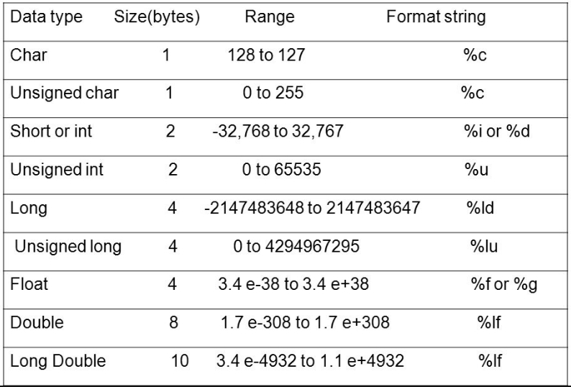
size != length in C

Slide 8
Integer Overflow
8-bit signed integer in C has a maximum value of 127 and a minimum value of -128.
If a programmer stores the value 127 in such a variable and adds 1 to it, the result should be 128.
However, this value exceeds the maximum for this integer type, so the interpreted value will “wrap around” and become -128.
Can lead to many issues, here it is a heap overflow.
https://github.com/chirlu/sox/blob/sox-14.4.0/src/xmalloc.h#L31

Slide 9
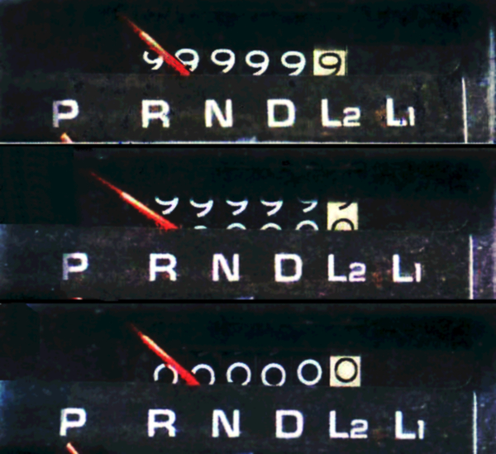

Slide 10
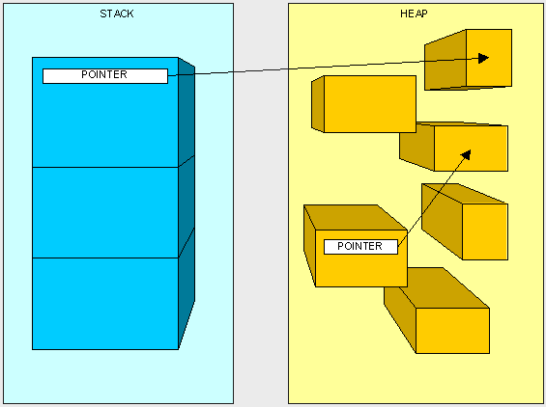
Heap

Slide 11
Heap Overflow
Heap is a memory region allotted to every program.
Unlike stack, heap memory can be dynamically allocated.
This means that the program can 'request' and 'release' memory from the heap segment whenever it requires.
Heap memory blocks are called chunks
A chunk can be busy or free
Very surgical memory corruption bugs relate to the heap.
Exploitation involves overwriting fixed function pointers to point to attacker code
https://github.com/chirlu/sox/blob/sox-14.4.0/src/remix.c#L234

Slide 12
Things we are trying to Answer
Exact input that triggered the crash: https://sourceforge.net/p/sox/bugs/320
What vulnerability was triggered: Integer Overflow
Type/Category of the crash: Heap Overflow
Where is the vulnerable code inside the package: xmalloc.h, lsx_valloc - Integer Overflow, heap-buffer-overflow is triggered in remix.c line 237
Exploitable: Not possible to answer in many cases

Slide 13
Next Steps
Build the correct Alpine Environment
Compile/Install the vulnerable version of the package
Use a debugger and payload to verify the vulnerability

Slide 14
Building a Vulnerable Environment: Alpine
Docker can be used: docker pull alpine
If a specific release is needed: docker pull alpine:3.9
To run locally: docker run -i -t alpine /bin/sh

Slide 15
APKBUILD
Contains the source origin
Version of the package used within Alpine
Patches used by Alpine
Alpine package repositories: https://pkgs.alpinelinux.org/package/edge/community/ppc64le/sox

Slide 16
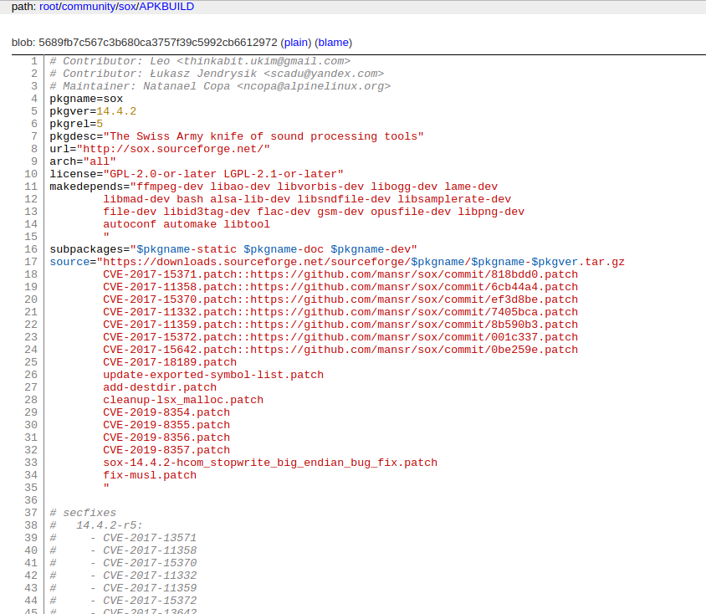
https://git.alpinelinux.org/aports/tree/community/sox/APKBUILD

Slide 17
Installing the Correct Package
Alpine make minor modifications to an upstream package in order to make it work correctly within Alpine.
We need to rebuild this package with Debug Symbols enabled
Alpine uses musl libc instead of glibc and most popular C packages can only be compiled using glibc
The sox package version available within alpine is 14.4.2-r5 and the vulnerable version of the upstream package is 14.4.2
The following commit tree can be used:
https://git.alpinelinux.org/aports/commit/community/sox/APKBUILD?h=3.10-stable&id=304c15f39c09cabeb81bbf573e0faa17c299236f

Slide 18
Modifying APKBUILD to allow Debug Symbols
Debug symbols provides additional information to a binary such as function names and shared libraries
helpful while trying to investigate a crash
Alpine and apktools by default will remove debug information when building packages
We need to modify our APKBUILD to allow this explicitly

Slide 19
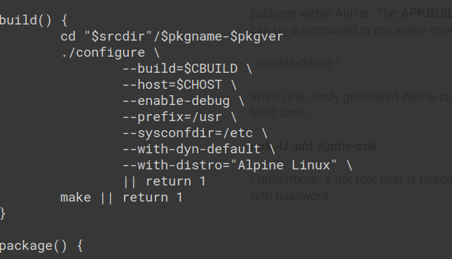
--enable-debug

Slide 20
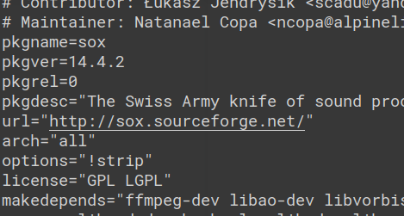
!strip

Slide 21
Building an Alpine Package Part 1
Install Alpine SDK Tools: apk -U add alpine-sdk
Non root user is needed to build a package within Alpine
adduser -D packager && addgroup packager abuild
echo -e "packager\npackager" | passwd packager
echo "packager ALL=(ALL) ALL" >> /etc/sudoers

Slide 22
Building an Alpine Package Part 2
Run the following commands to build an Alpine Package
su - packager
abuild-keygen -a -i
abuild -r
Will install all build tools, package dependencies and will fetch the source code of the package

Slide 23
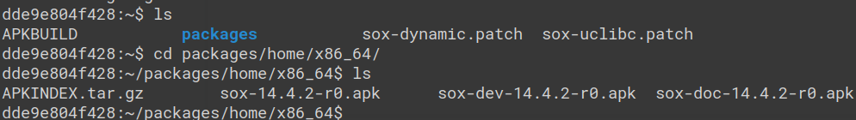
Building an Alpine Package Part 3
This apk can now be installed within alpine by using apk add
apk add /home/packager/packages/home/x86_64/sox-14.4.2-r0.apk --allow-untrusted

Slide 24
Fetching Vulnerable Source Code
Needed during analysis and debugging process
Always check that the upstream origin and APKBUILD origin is the same
git clone https://git.code.sf.net/p/sox/code sox-code
cd sox-code/
git checkout sox-14.4.2

Slide 25
Debugging
Debuggers are used for dynamic analysis
A good debugger will have several useful features such as breakpoints, step into, memory searching etc
We will use GeF which is built on top of vanialla GDB (GNU Debugger)
Link: https://github.com/hugsy/gef
apk add gdb
wget -O ~/.gdbinit-gef.py -q https://github.com/hugsy/gef/raw/master/gef.py
echo source ~/.gdbinit-gef.py >> ~/.gdbinit

Slide 26
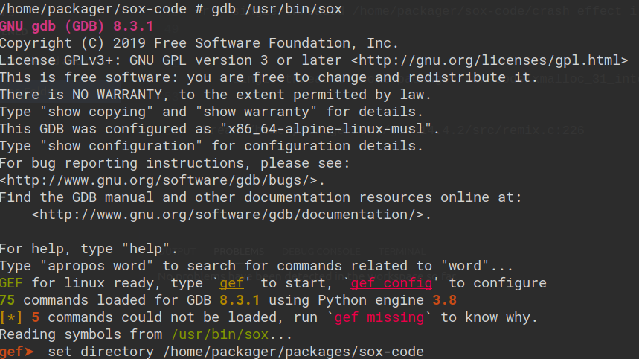
Reproducing the Crash
Start GDB with Sox: gdb /usr/bin/sox
Link the debug session to the source code: set directory /home/packager/packages/sox-code

Slide 27
Helpful GEF/GDB Commands
break <where> Set a new breakpoint.
Clear Delete all breakpoints.
where full Show call stack, also print the local variables in each frame
Run Run the program within GDB
Step Go to next instruction
info files Show all files part of the program
info sources Show source directory
info functions Show all functions

Slide 28
Reproducing the Crash
https://sourceforge.net/p/sox/bugs/320/ tells us where the heap allocation is
Review the source code to check where the function allocating to heap is
Set breakpoint: break /home/packager/src/sox-14.4.2/src/remix.c:226
Run the PoC:
run --single-threaded /home/packager/sox-code/xmalloc_31_integer_overflow.mp3 -t aiff /dev/null channels 1 rate 16k fade 3 norm

Slide 29
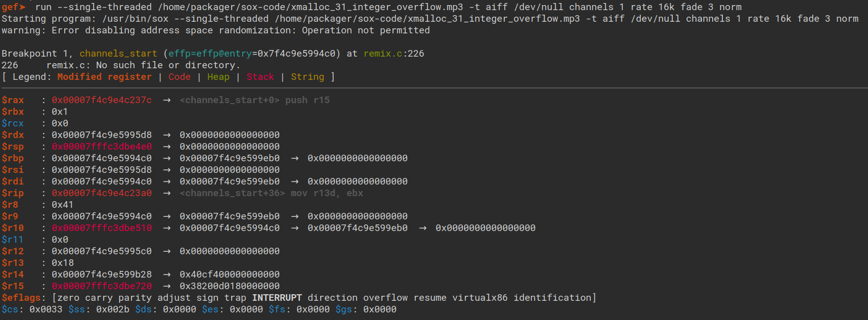
https://gef.readthedocs.io/en/master/commands/heap/

Slide 30
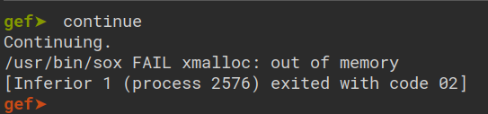
Reproducing the Crash
We can reproduce the crash
The vulnerable code is correct/accurate
Cannot analyse crash properly and cannot examine heap due to Musl and no tools supporting it :(
However xmalloc being used and program crashing due to out of memory is good indication

Slide 31
Conclusion: Things we are trying to Answer
Exact input that triggered the crash: https://sourceforge.net/p/sox/bugs/320 ✔️
What vulnerability was triggered: Integer Overflow ✔️ (err Maybe)
Type/Category of the crash: Heap Overflow ✔️
Where is the vulnerable code inside the package: xmalloc.h, lsx_valloc - Integer Overflow, heap-buffer-overflow is triggered in remix.c line 237 ✔️
Exploitable: Not possible to answer in many cases

Slide 32
Further Reading
https://legacy.gitbook.com/book/dhavalkapil/heap-exploitation
https://vulncat.fortify.com/en/detail?id=desc.controlflow.cpp.integer_overflow
https://gef.readthedocs.io/en/master/
https://github.com/jfoote/exploitable/blob/master/exploitable/lib/rules.py

